Slide 1

Maulana Azad National Institute of Technology Bhopal, Madhya Pradesh
Mathematics, Bioinformatics and Computer Application
Minor Project - I (CA - 308)
E-Learning Platform
Prepared By :
Ankit Yadav - 2320403243
Monu Meena - 2320403244
Ankush Patidar - 2320403245
Vishal Jatav - 2320403236
Vishal Patidar - 2320403247
Project Mentor :
Prof. Amit Bhagat

Slide 2


Introduction :
An “E-Learning” website provides a platform for students, instructors, and administrators to engage in online education.
A dynamic online platform designed to facilitate learning through a wide variety of courses across different domains.

Slide 3
Functional Requirements:
User Registration and Authentication :
Allows users to create accounts, log in securely, and manage their profiles with OTP verification and password protection.
Course Management :
Enables instructors to create, update, and publish courses, including details, pricing, and multimedia content.
Course Enrollment :
Facilitates students' registration in courses and grants them access to course materials..
Course Content Delivery :
Delivers structured learning materials like videos and texts, organized into lessons or modules.
Student Dashboard :
Provides students with an overview of their enrolled courses, progress, and upcoming activities.
Reviews and Ratings :
Allows students to leave feedback and rate courses based on their learning experience
Wishlist and Cart :
Lets users save courses they are interested in and add them to a cart for future enrollment or purchase.

Slide 4





Search and Filters :
Helps users find courses by keywords, categories, or other criteria and apply filters for a refined search.
Admin and Instructor Panel :
Provides administrative tools for managing users, moderating content, and overseeing platform operations.
Discounts and Pricing :
Manages course pricing and applies discounts or promotional offers to attract and retain students.
Progress Tracking :
Monitors and displays students' progress through their courses, including completed and pending content.
Security:
Implements measures such as OTP, encryption, and secure payment processing to protect user data and
transactions.

Slide 5
Non-Functional Requirements:
Performance :
The platform should handle a high volume of concurrent users and deliver content quickly with minimal latency.
Scalability :
The system must be able to scale up to accommodate increasing numbers of users, courses, and data without performance degradation.
Reliability:
The website should have high availability and be resilient to failures, ensuring consistent performance and minimal downtime.
Usability:
The user interface must be intuitive and user-friendly, allowing users to navigate and interact with the platform effortlessly.
Compatibility:
The website should function correctly across various browsers and devices, including desktops, tablets, and smartphones.
Maintainability:
The website should function correctly across various browsers and devices, including desktops, tablets, and smartphones.

Slide 6
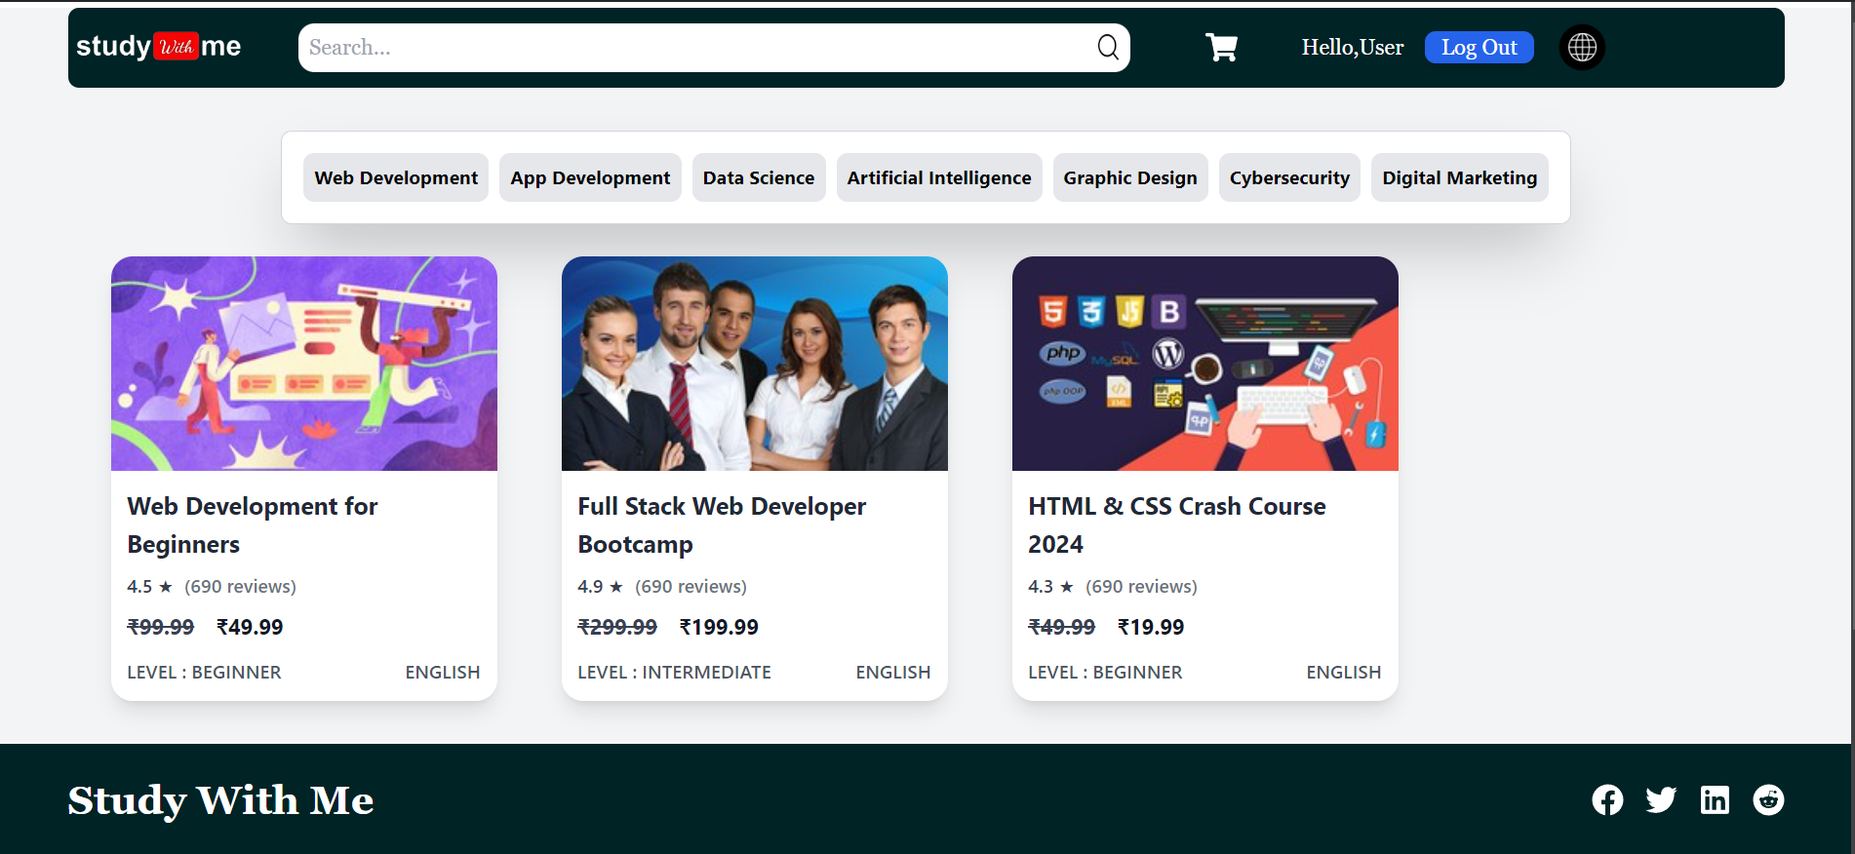
User Interface :

Slide 7
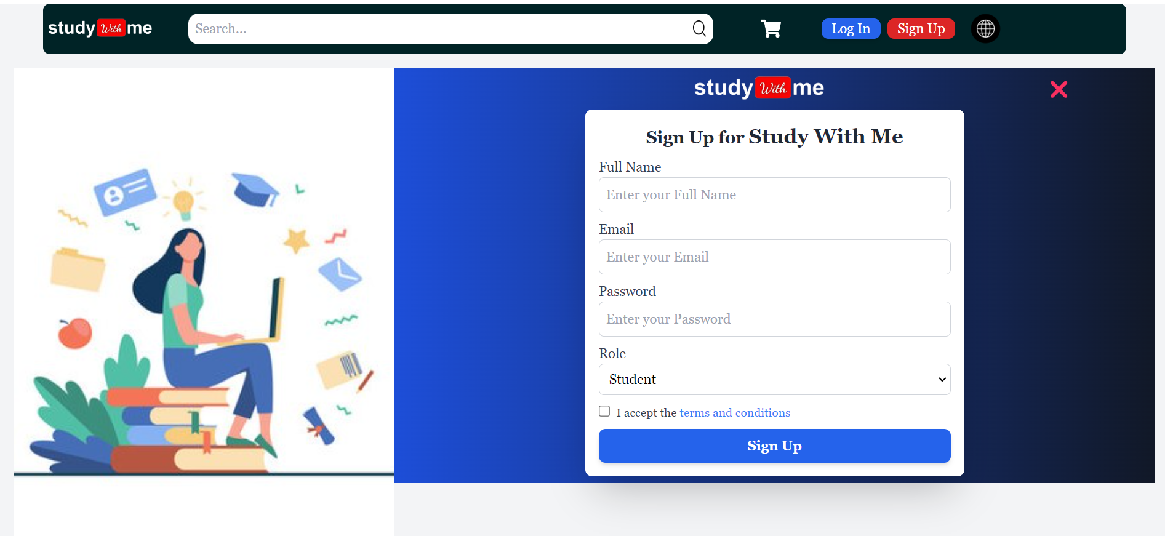
Register Page

Slide 8
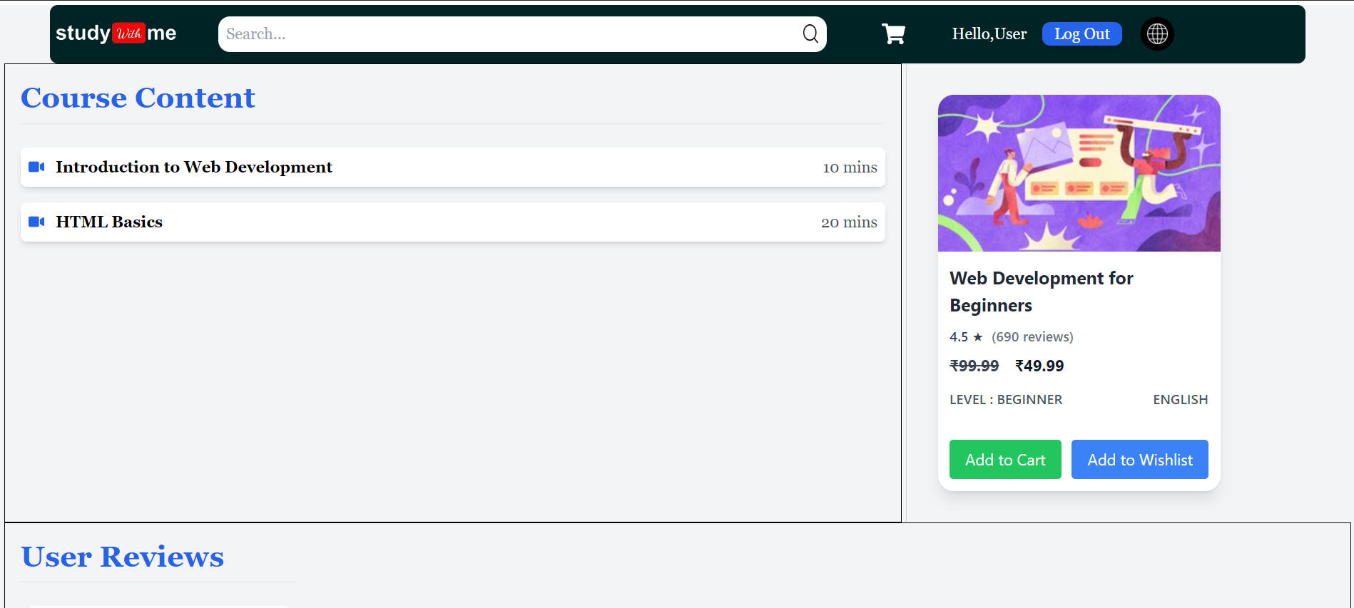
Course Content Page

Slide 9
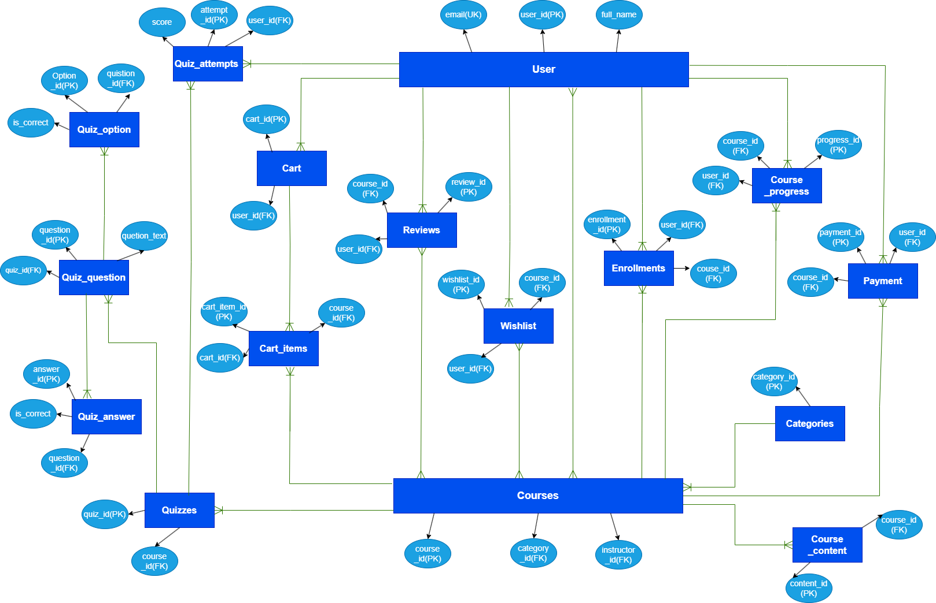
ER - Diagram :

Slide 10
